Slide 1



DEPARTMENT OF COMPUTER SCIENCE & ENGINEERING
SCHOOL OF COMPUTING
10214CS602 MINOR PROJECT -2
WINTER SEMESTER(2023-2024)
INITIAL REVIEW
“"Plant Health Management: CNN for Disease Detection & Treatment Recommendations"”
SUPERVISED BY
PRESENTED BY
MR. R. VINOTH KUMAR
1.Y.HARSHA DEEPAK (VTU 20507)(21UECS0685)
2.P.NIRANJAN (VTU)()
3. (VTU )()

Slide 2
PROJECT TITLE JUSTIFICATION
Uses advanced CNN and transfer learning methods to accurately detect plant diseases.
Offers personalized suggestions for medication and treatment procedures based on identified diseases.
Focuses on simplifying plant health management by incorporating cutting-edge technology for disease diagnosis and treatment.
Provides practical solutions for addressing plant health issues through precise diagnosis and targeted treatment plans.

Slide 3
OBJECTIVE & SCOPE OF THE PROJECT
Objective:
Develop a system using CNN to accurately spot plant diseases.
Provide customized treatment advice for diagnosed plant issues.
Scope:
Utilize CNN technology to detect a variety of plant diseases effectively.
Assess the practicality of using CNN-based disease detection in real-world plant health management.
Explore options for integrating CNN recommendations into current plant health management practices.

Slide 4
TOOLS TO BE USED IN THE PROJECT
Convolutional Neural Networks (CNNs)
Deep Learning Frameworks
Disease Detection Algorithms
Treatment Recommendation Systems
Cloud Computing Services

Slide 5
SOCIETAL IMPORTANCE OF THE PROJECT
The project is really important for many reasons. First, it helps farmers keep their crops healthy, so they can produce more food and earn more money. It also helps protect the environment by reducing the need for harmful pesticides. By making sure plants stay healthy, it also keeps the food we eat safe. Plus, it brings new ideas and technology to farming, making it better for everyone. And finally, it gives farmers easy-to-use tools to take care of their crops, no matter where they live or how big their farm is

Slide 6
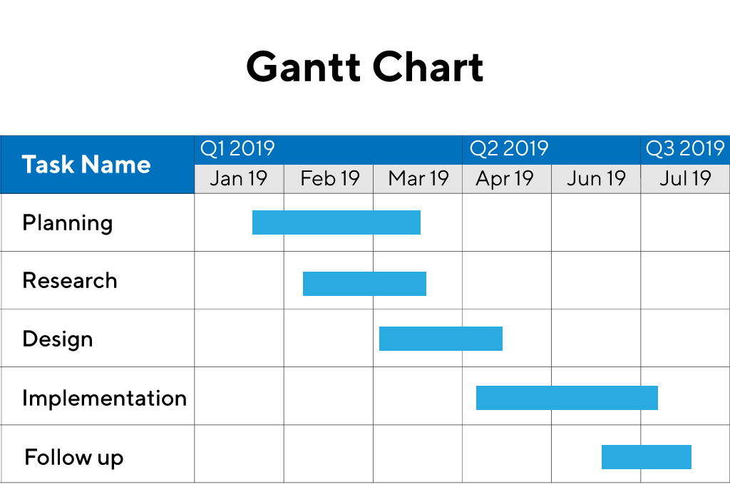
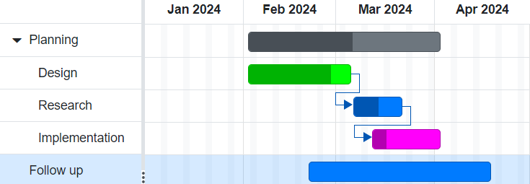
TIMELINE OF THE PROJECT
Sample Gantt Chart

Slide 7

THANK YOU

